Slide 1
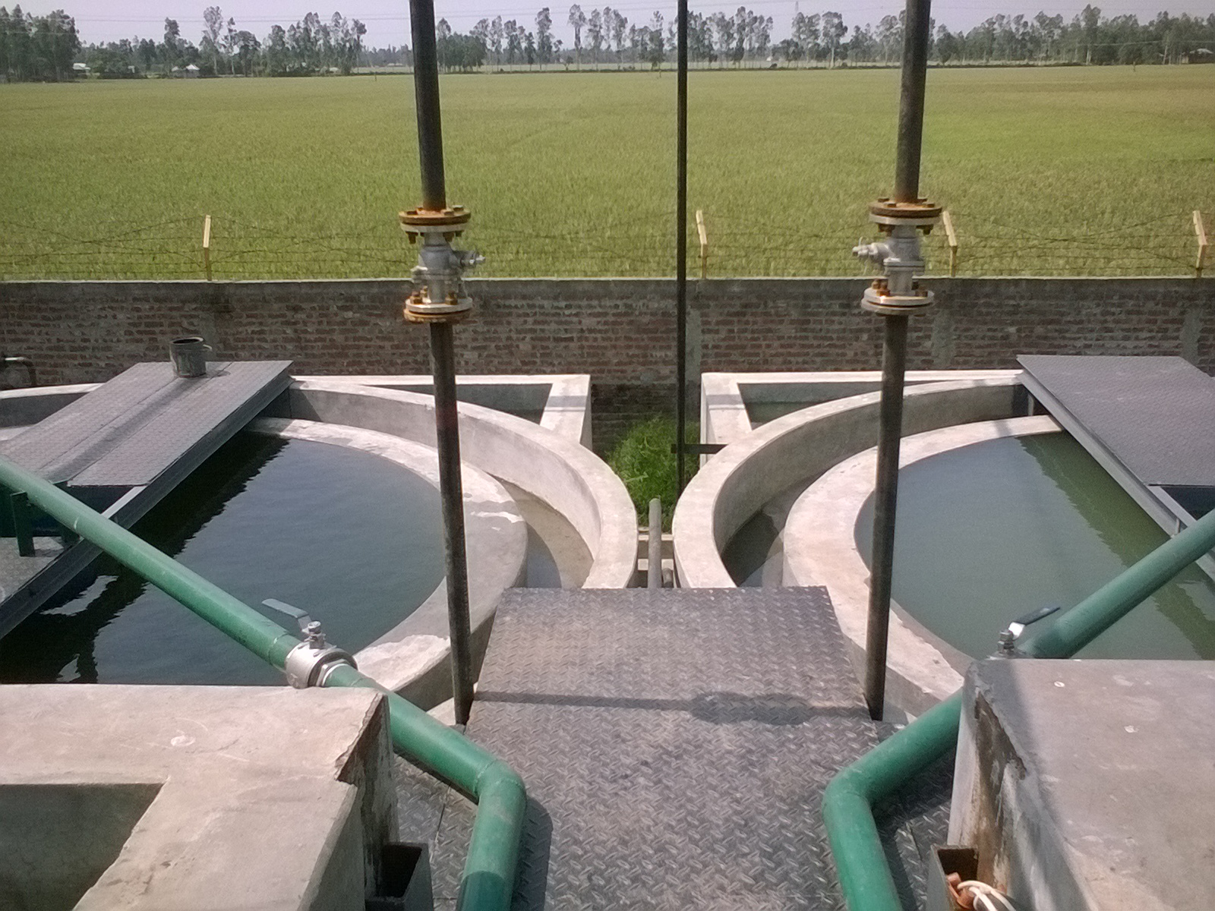
Effluent Treatment Plant.
Western Agro Products Limited.
Amboil, Sherpur, Bogra,
Bangladesh.

Slide 2
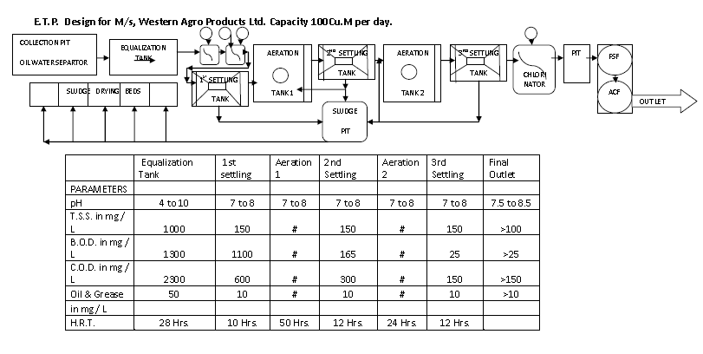
Process Flow Block Diagram.

Slide 3
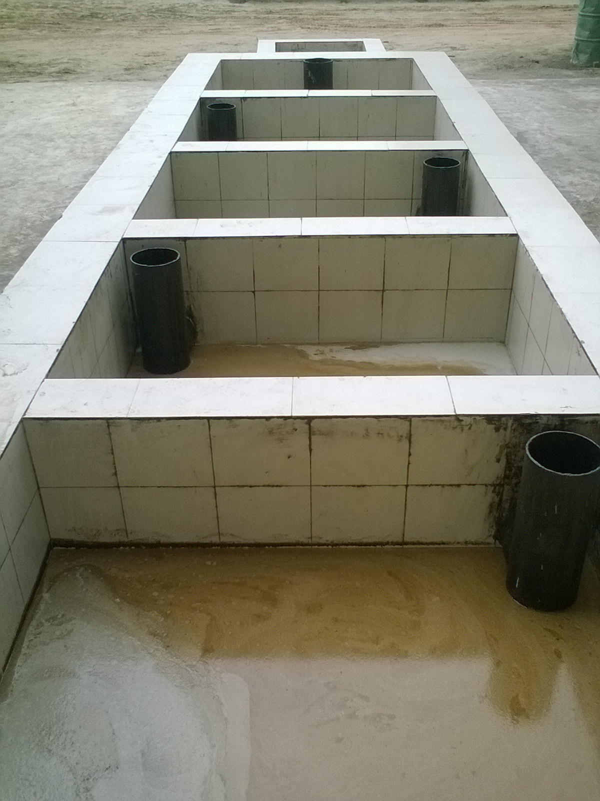
Pre-Primary treatment of effluent from RBO refinery unit.

Slide 4
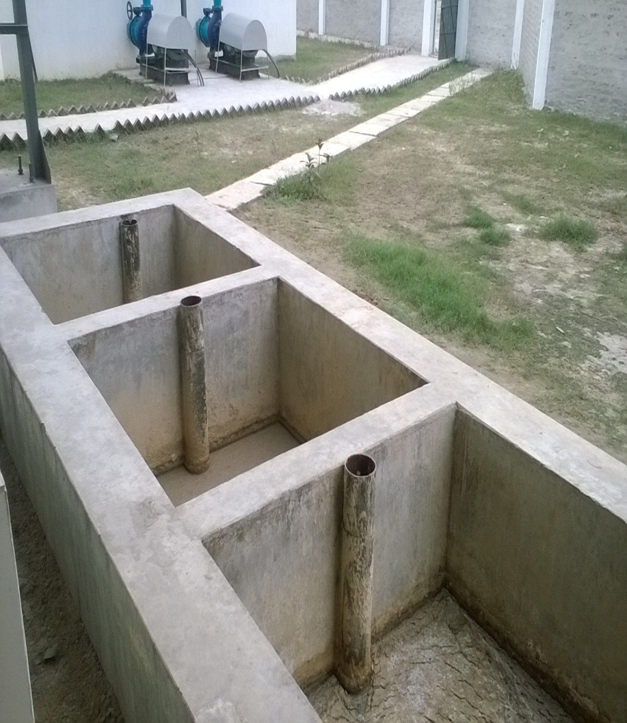
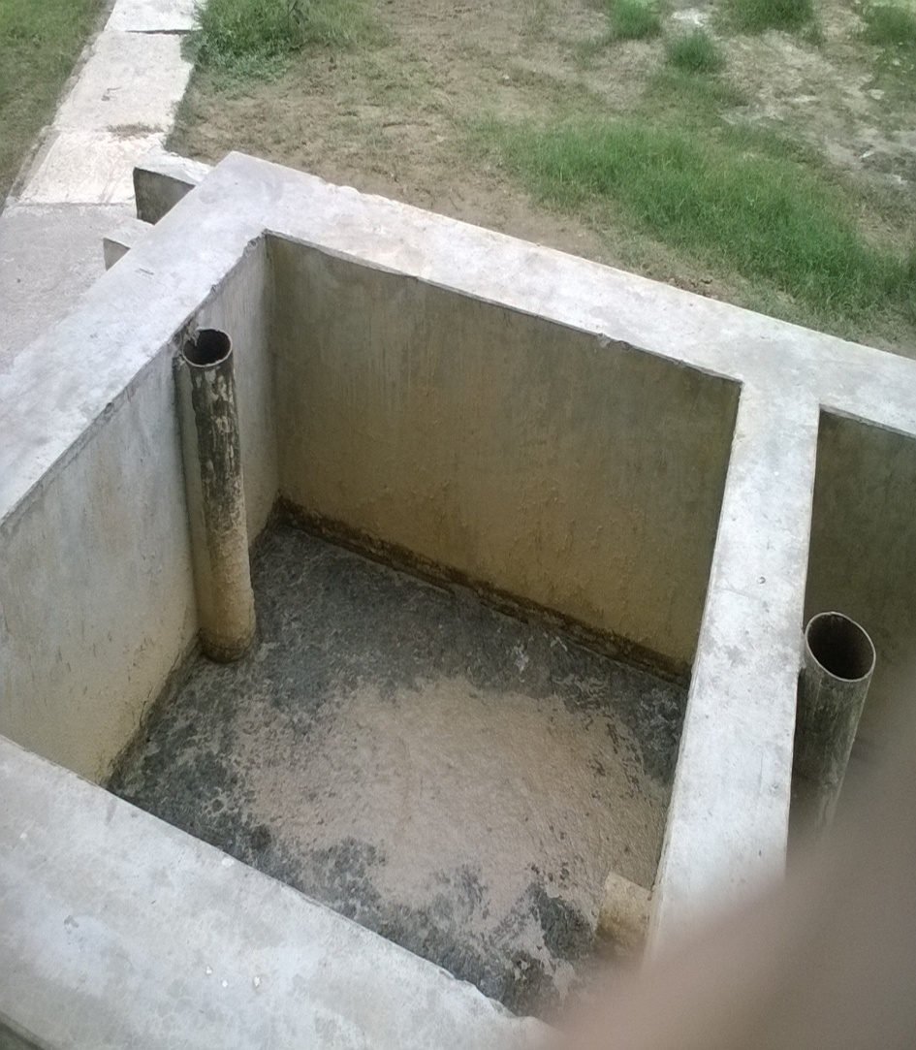
Pre-Primary Treatment of effluent from SEP unit.

Slide 5
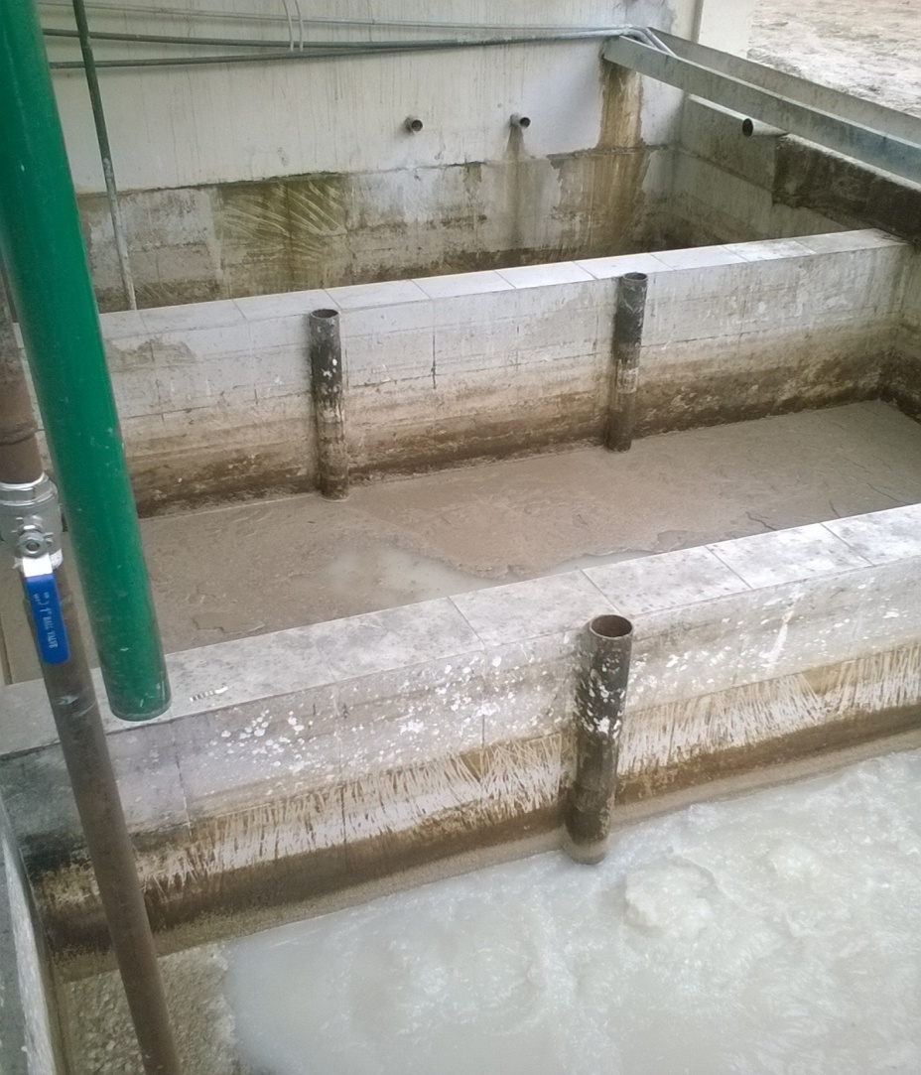
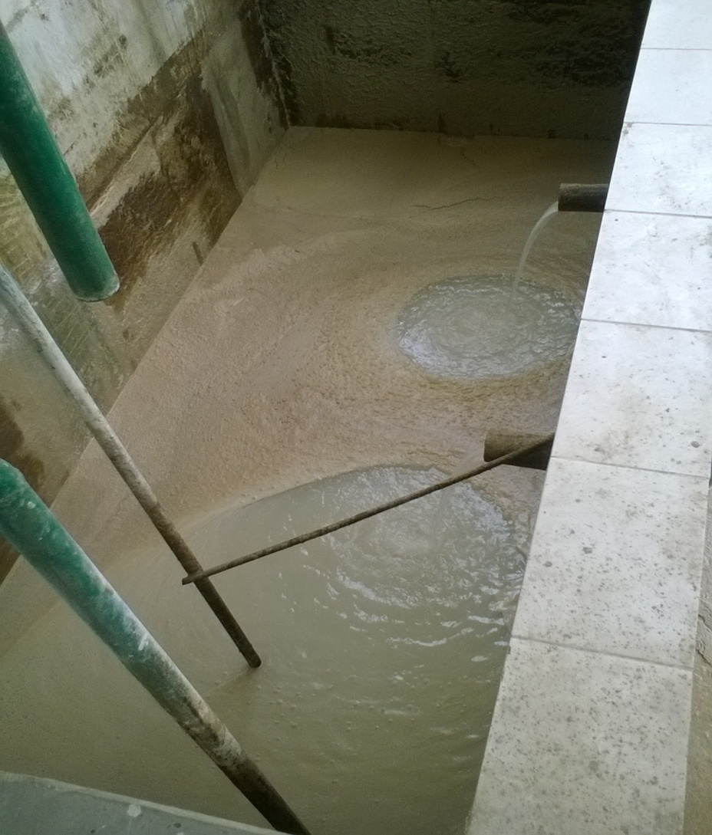
Equalization Tank

Slide 6
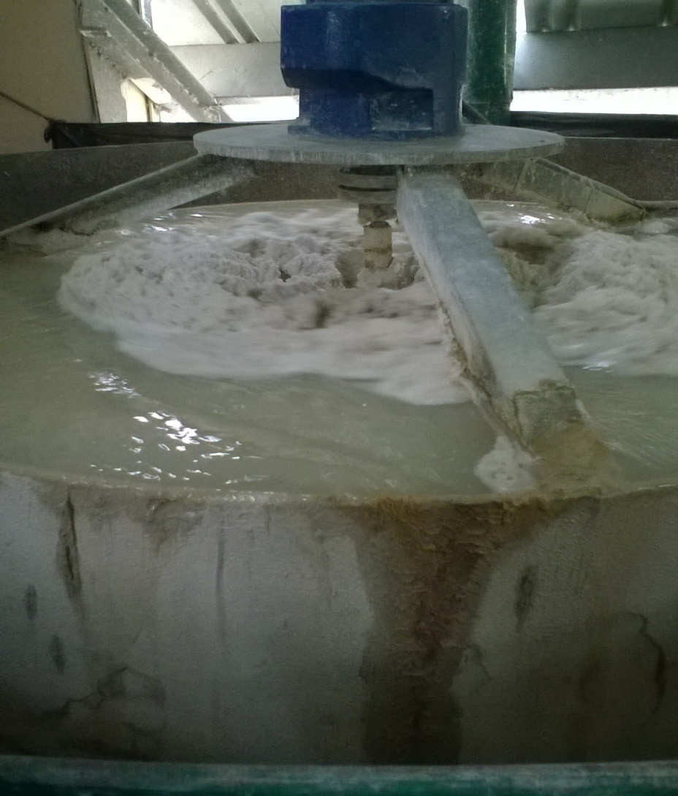
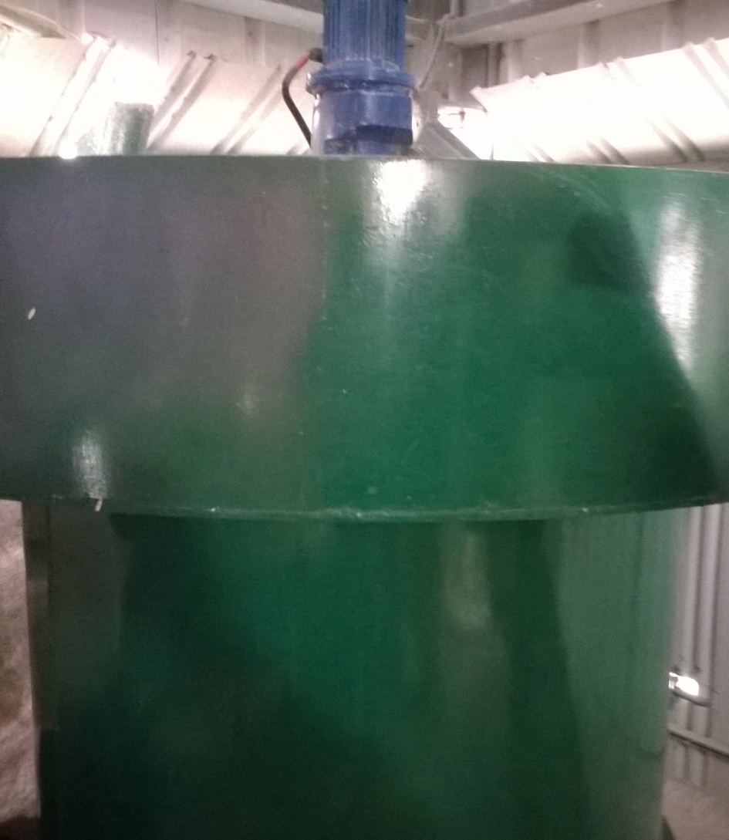
Continuous Chemical Mixing unit

Slide 7
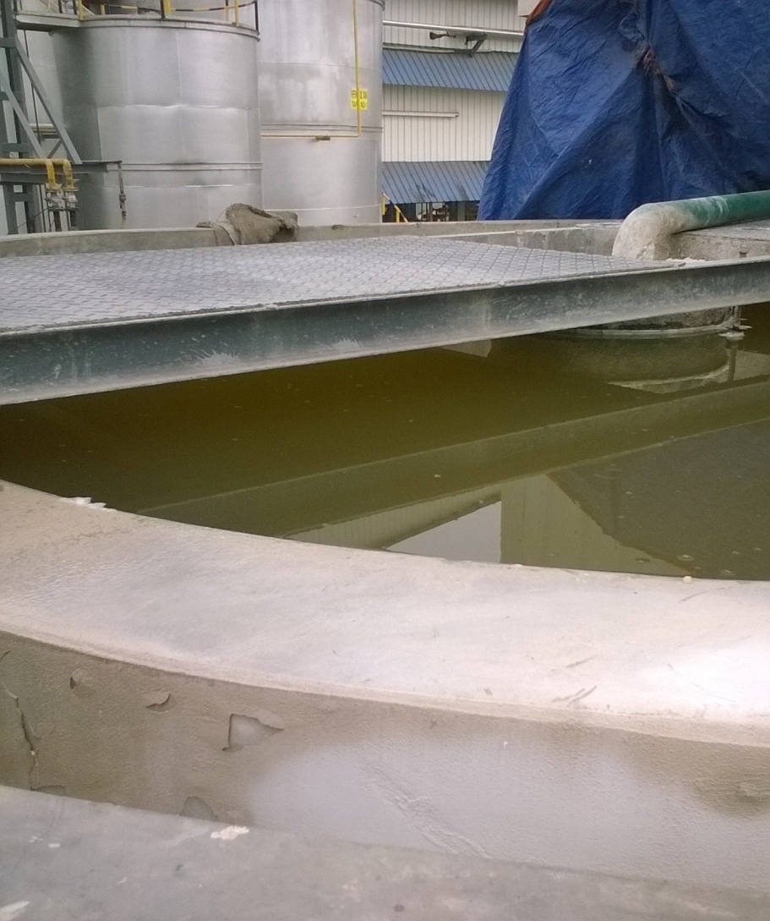
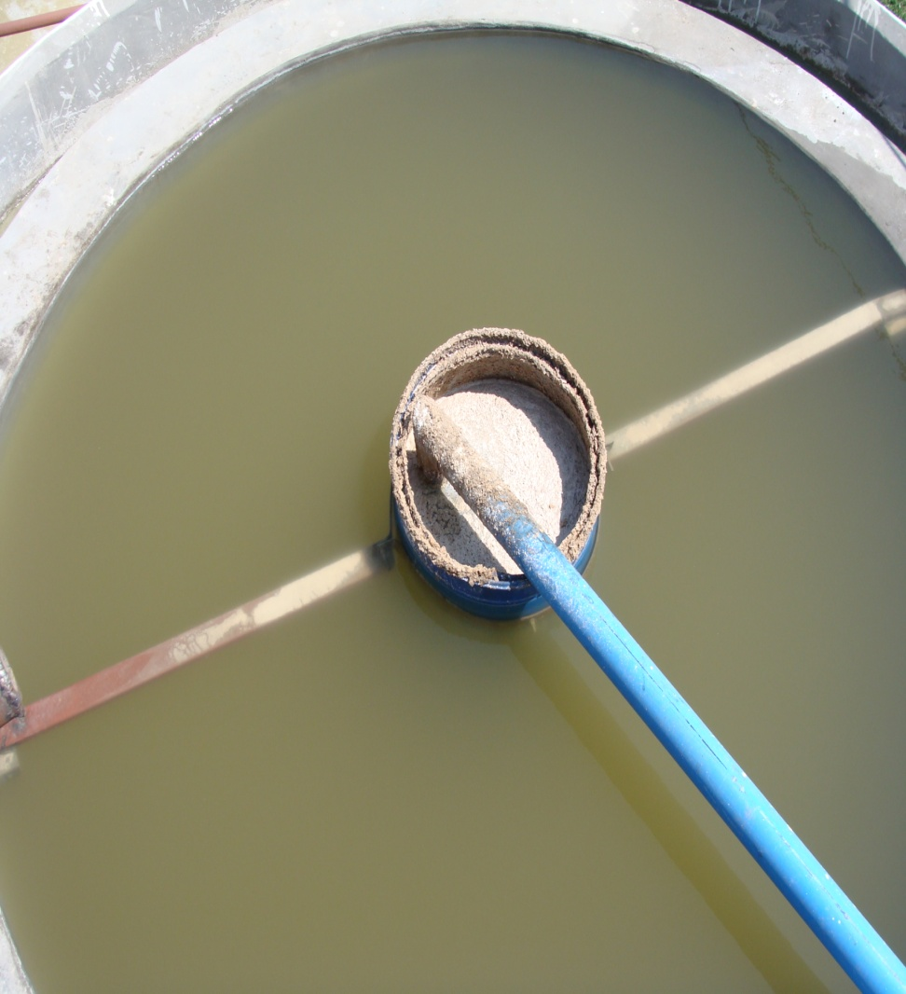
Primary Clarifier / Settling tank.

Slide 8
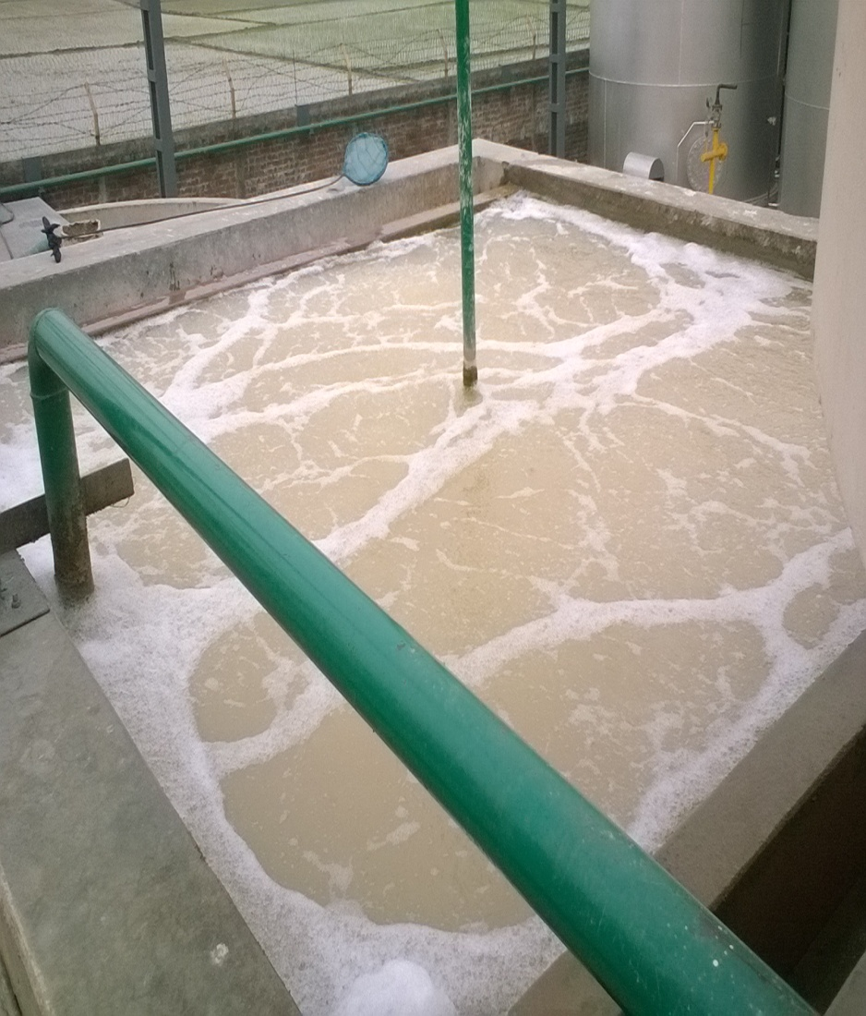
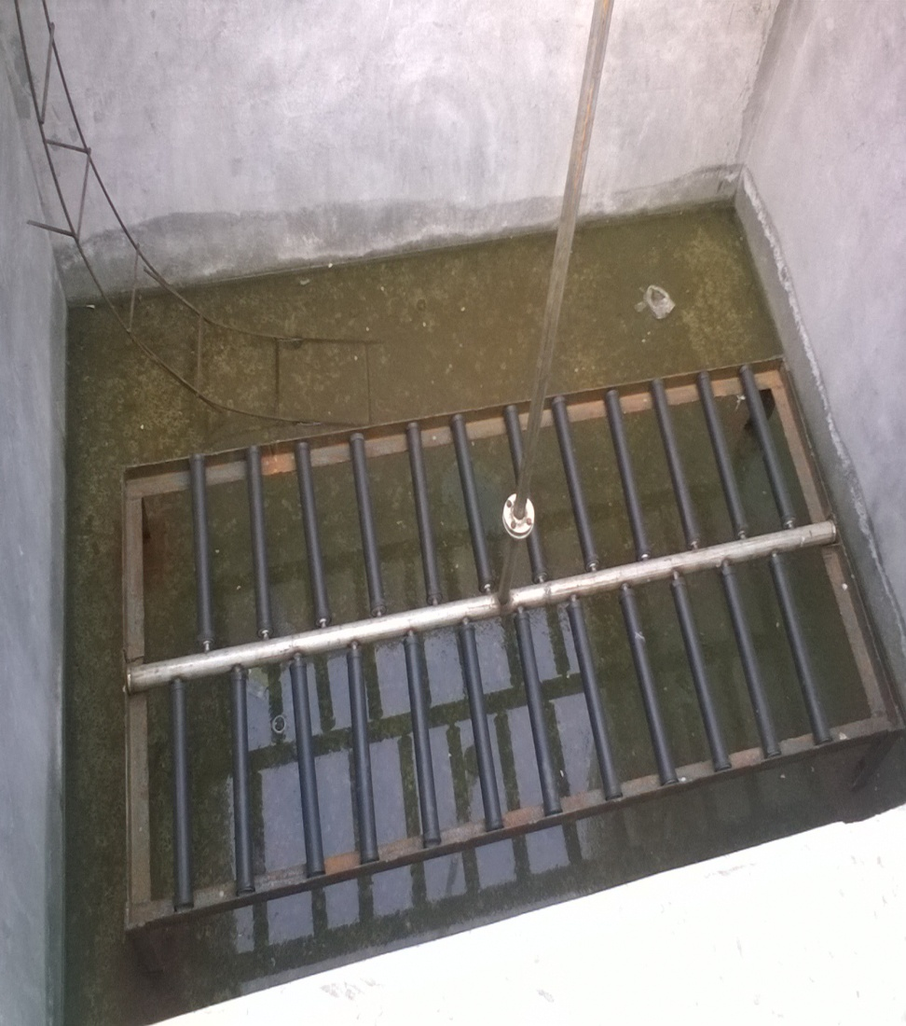
Aeration Tank 1.

Slide 9
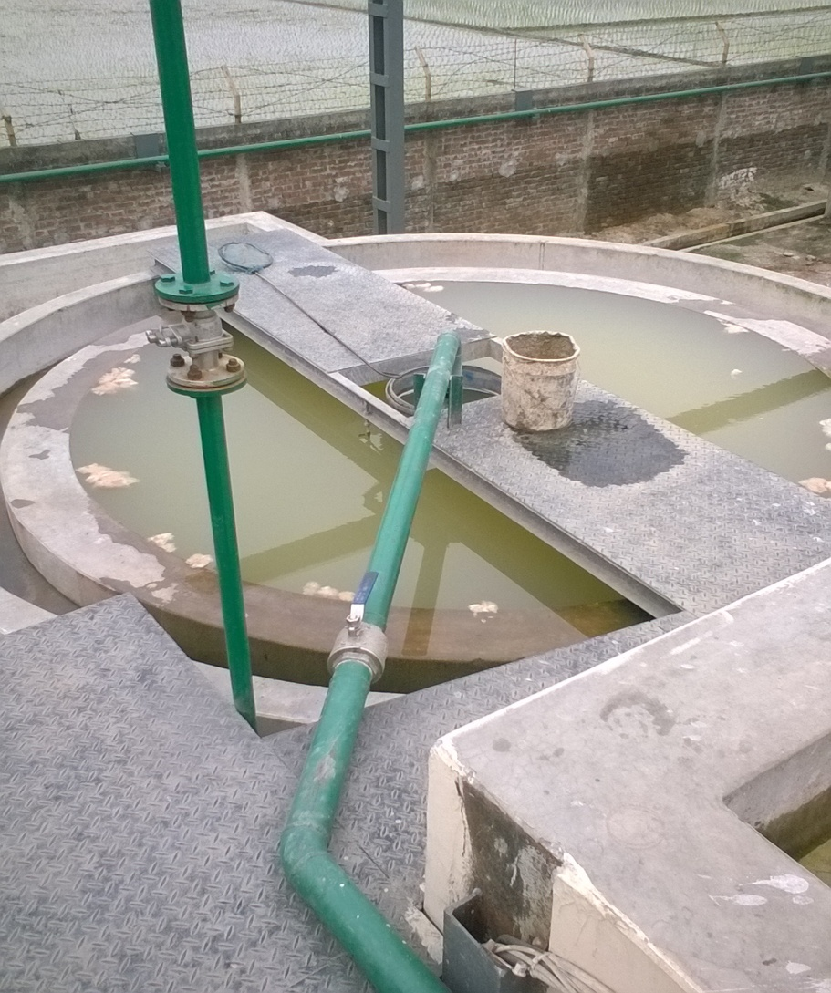
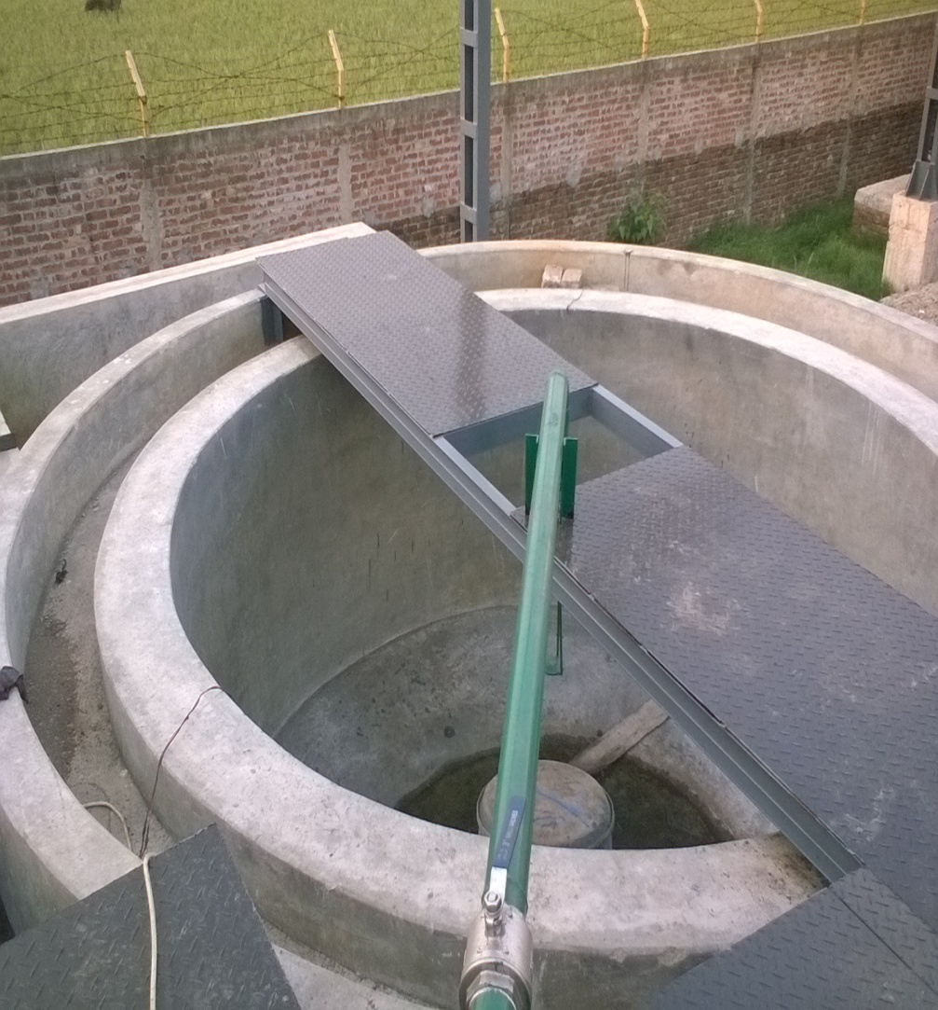
Secondary Clarifier / Settling tank.

Slide 10
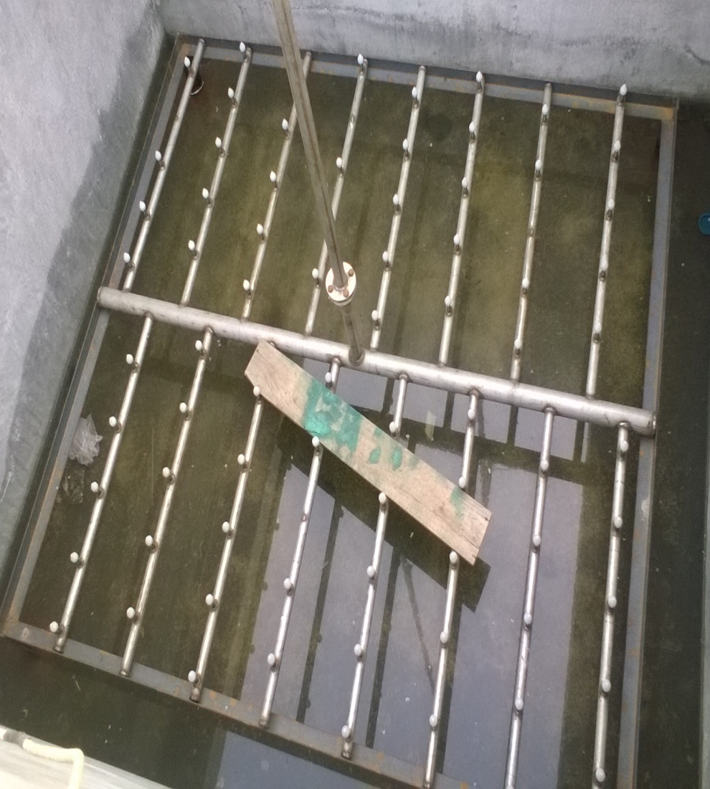
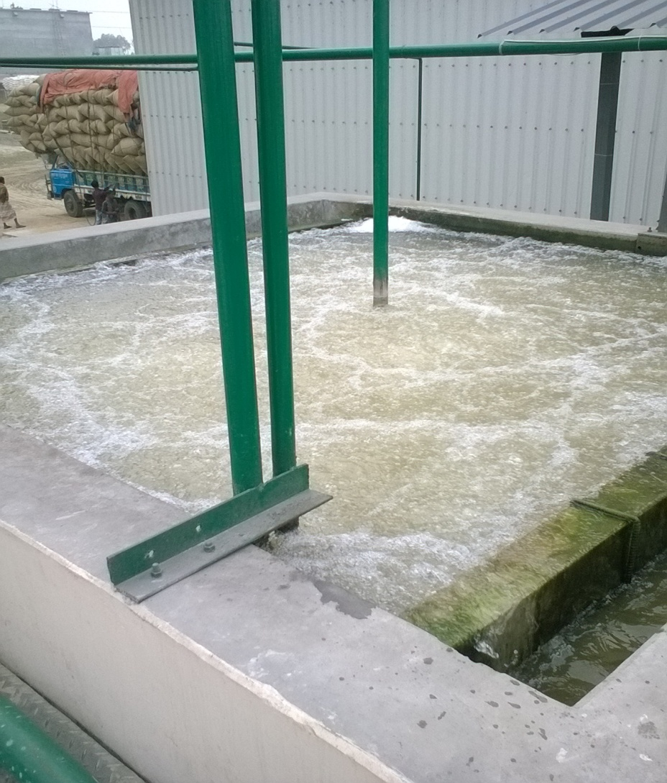
Aeration tank 2.

Slide 11
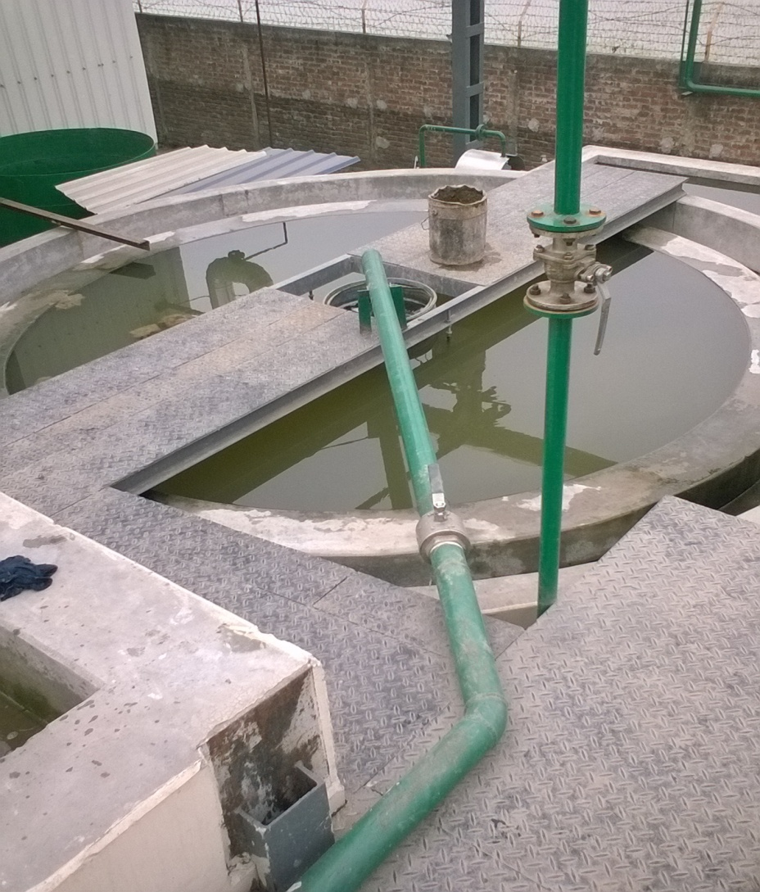
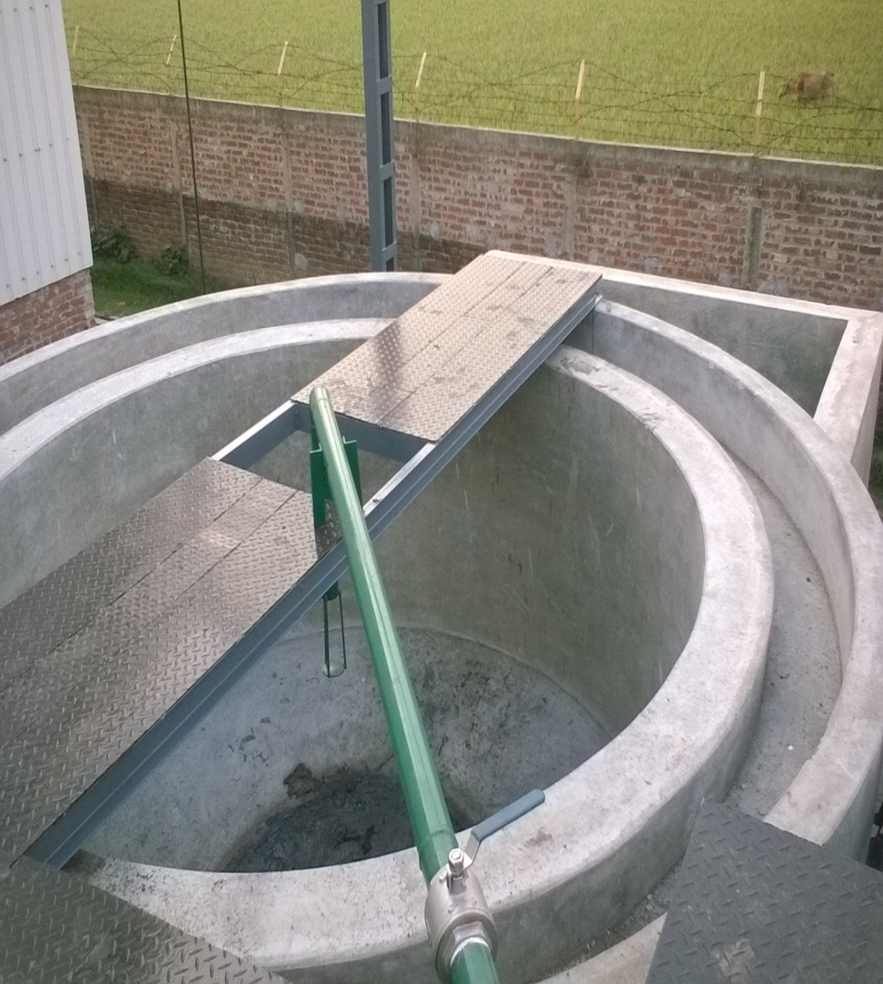
Tertiary Clarifier / Settling tank.

Slide 12
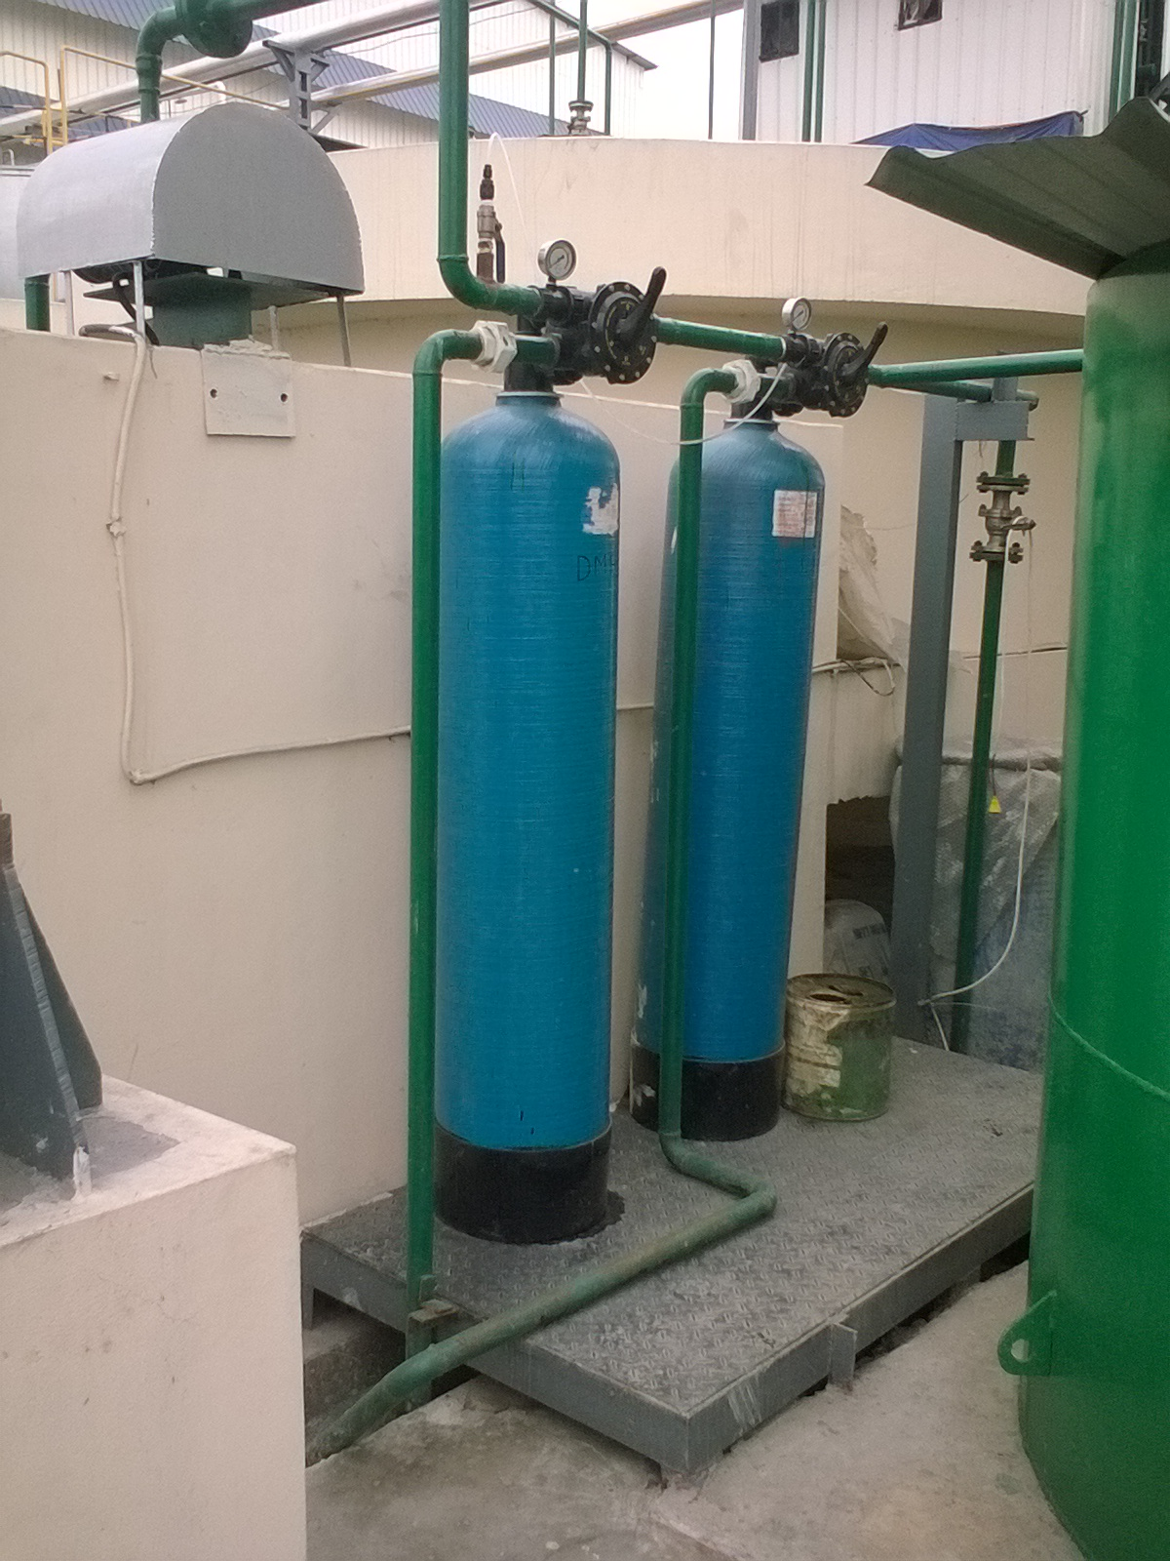
D.M.F. & A.C.F.

Slide 13
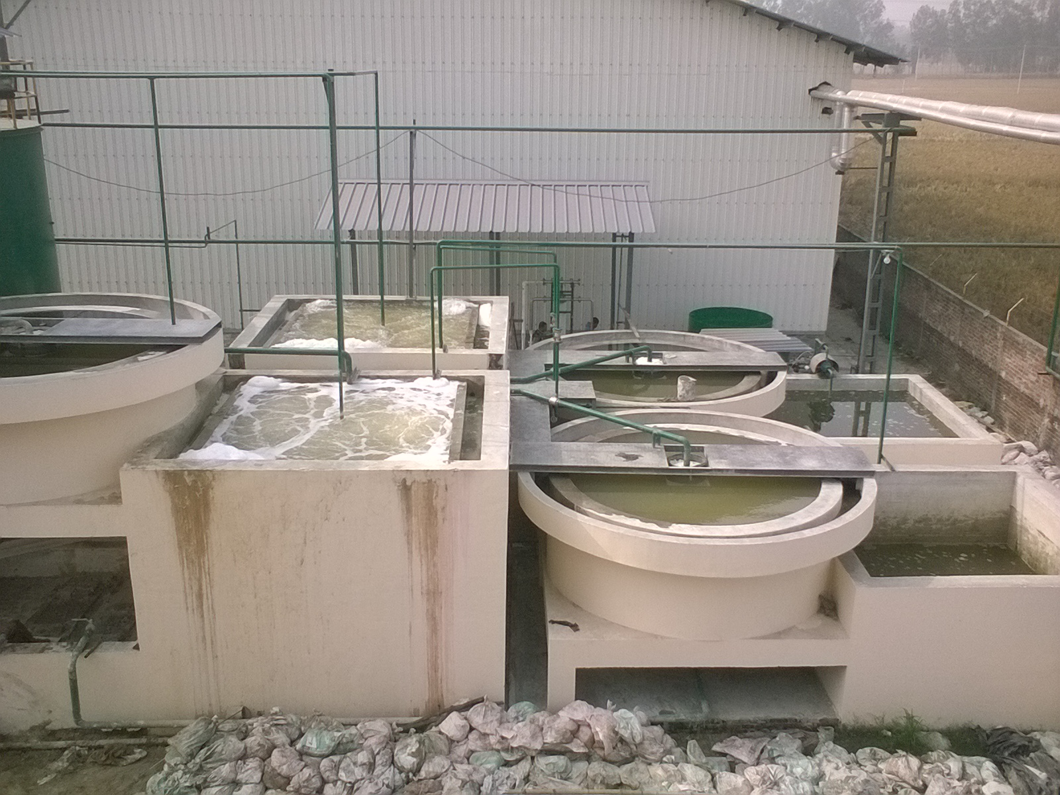
Top View of E.T.P.

Slide 14
Ultrafiltration Unit
Target-
To become zero discharge plant.

Slide 15
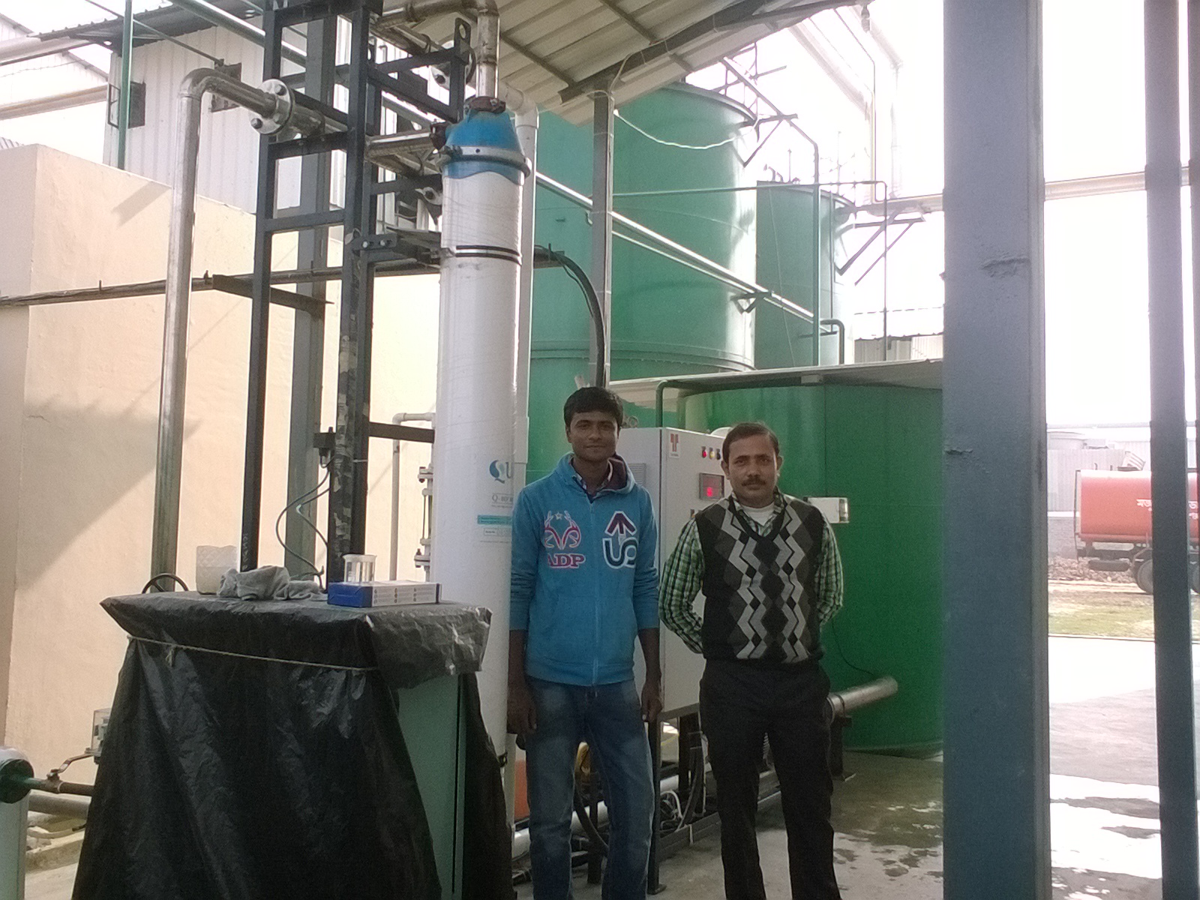
ULTRAFILTRATION

Slide 16
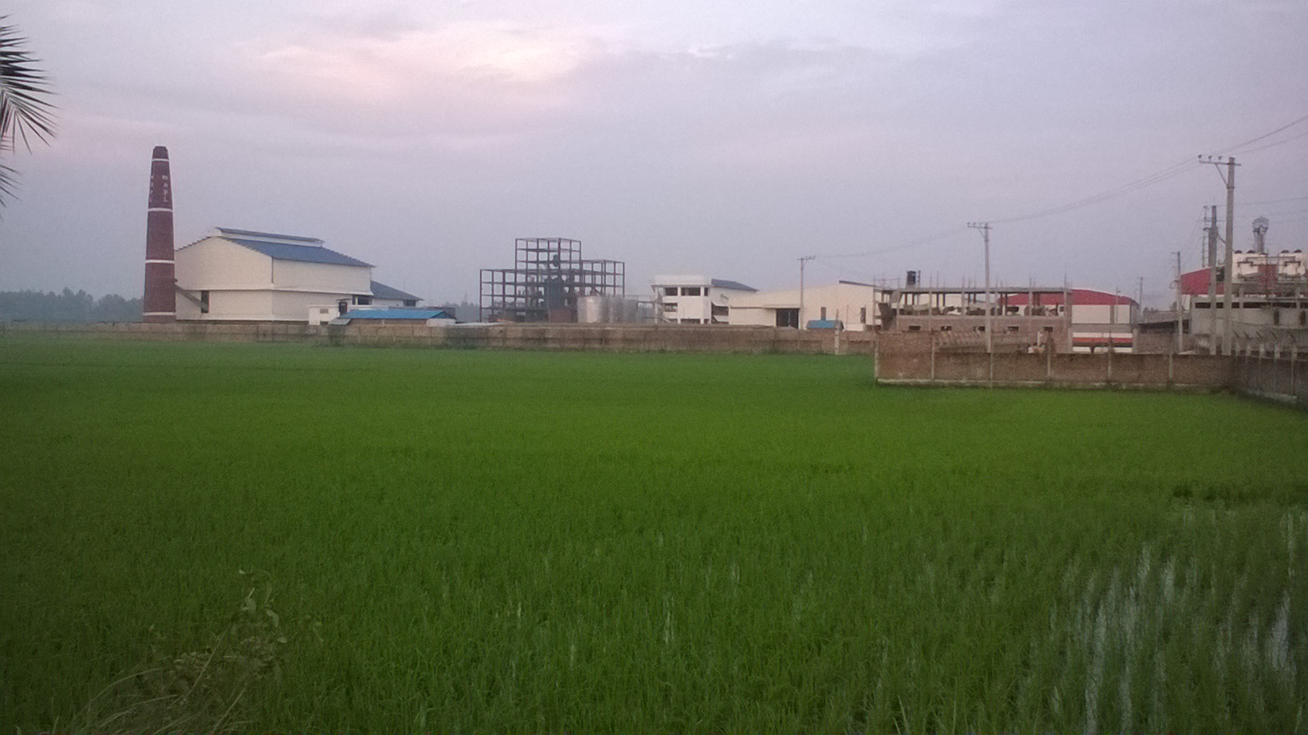
THE ZERO DISCHARGE UNIT

